Slide 1
CS152 Section 5
Midterm 1 Review

Slide 2
Administrivia
See pinned Piazza post for midterm logistics
Check bMail for a confirmation email with your private Zoom link
Test meeting link ahead of time
Single-page double-sided letter-sized handwritten cheatsheet allowed
Append cheatsheet to submission
No other external resources permitted

Slide 3
General Tips
Some problems may involve new variations on a basic design, but a solid understanding of the fundamentals will help you reason about new designs
e.g., what are the implications of making a particular modification?
Consider how architectural features interact with each other
e.g., how does virtual memory impact cache design?
“Cross-cutting issues” sections in textbook can give perspective
State assumptions

Slide 4
Topics To Cover Today
Ordered by interest level from survey:
Pipelining
Virtual memory
Memory hierarchy
Microcoding
Iron law

Slide 5
Hazards
Structural hazards
Shared bus, register file ports, unpipelined functional units, etc.
Data hazards: RAW, WAR, WAW
How can WAW hazards arise in an in-order pipeline?
Consider through memory as well
Control hazards
Where in a pipeline are unconditional direct jumps (JAL), unconditional indirect jumps (JALR), and conditional branches resolved?
Know what the jump/branch penalties are for a given pipeline

Slide 6
Pipelining
What are the bypass paths in a fully-bypassed 5-stage datapath?
Does it ever make sense to bypass from the end of a stage to the start of a stage?
When can you “remove” a bypass path? What can make a bypass path unnecessary?
Latency vs throughput/bandwidth vs occupancy
How to calculate CPI
Measure from when the first instruction finishes to when last instruction finishes
CPI of 5-stage pipeline ≠ 5 when no stalls
What is a critical path in synchronous digital logic?

Slide 7
Exceptions
Synchronous traps vs asynchronous interrupts
Precise vs imprecise exceptions
How to implement precise exceptions in a pipeline
Where is the commit point in a pipeline?

Slide 8
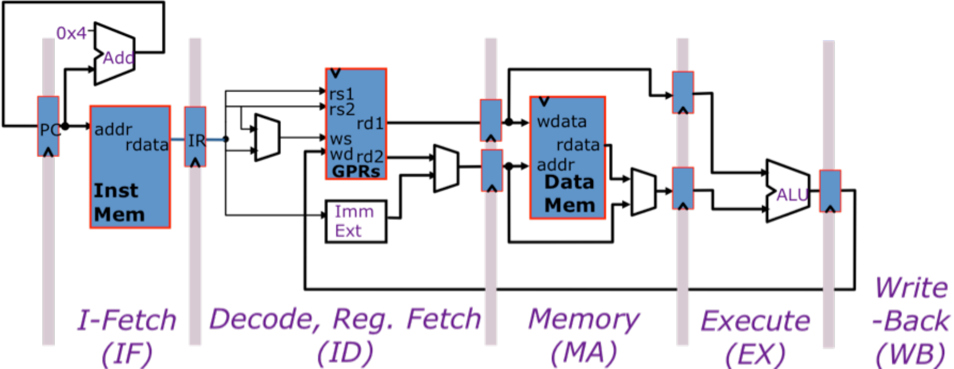
Mem-ALU Pipeline (2009 Quiz 1 Q2)
We modify the 5-stage pipeline to support register-memory ALU operations. Only register-indirect addressing is allowed for memory operations (no offset).

Slide 9
Mem-ALU Pipeline (2009 Quiz 1 Q2)
Describe bypass paths needed to make the rearranged pipeline fully-bypassed:

Slide 10
Mem-ALU Pipeline (2009 Quiz 1 Q2)
lw a0, (a0)
addi a1, a0, 0x4
sw a0, (a1)
beq a1, 0x0, end
lw a0, (a0)
CPI of this code?
Data hazards?
Control hazards?
Structural hazards?

Slide 11
Mem-ALU Pipeline (2009 Quiz 1 Q2)
Data hazards removed: Give an instruction sequence where the original pipeline will stall but this new pipeline will not.
Data hazards added: Give an instruction sequence where this new pipeline will stall but the original pipeline will not.

Slide 12
Mem-ALU Pipeline (2009 Quiz 1 Q2)
Propose a microarchitectural modification to this pipeline that adds support for register-immediate addressing with loads/stores (non-zero offsets):

Slide 13
Mem-ALU Pipeline (2009 Quiz 1 Q2)
Propose how to maintain precise exceptions with this rearranged pipeline:

Slide 14
Virtual Memory
Motivations for address translation
Paging vs segmentation
Hierarchical page tables
How many PTEs are in each level of the page table?
What portion of the virtual address space do non-leaf PTEs map?
Page table walk
How does the page table walker determine the location of the next level page table?
TLBs
Compare TLBs to normal data caches
What happens on a context switch?
Aliasing
How can aliasing occur in a virtually addressed cache?
Why not build only physically addressed L1 caches?
Where can aliases reside in a direct-mapped/set-associative cache?

Slide 15
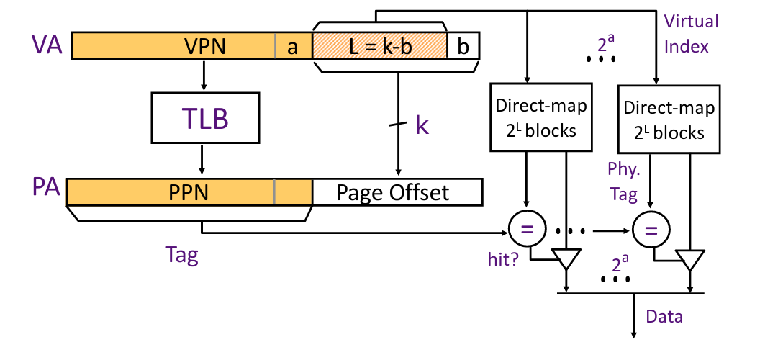
VIPT Caches
VIPT: virtually indexed, physically tagged
TLB lookup performed in parallel with cache access
Tag check uses translated physical address
Why is it safe to use the page offset for indexing?
Virtual addresses that map to the same physical address always have identical page offsets

Slide 16
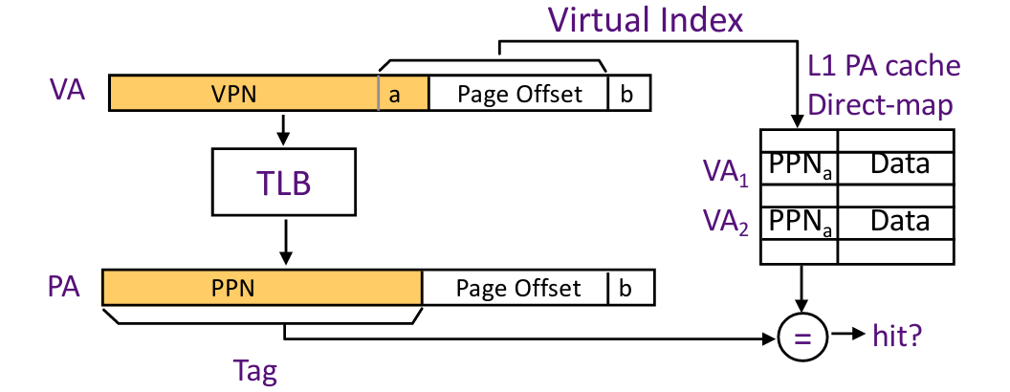
VIPT and Aliasing
Constraint: (number of sets * cache line size) ≤ page size
What if index overlaps with VPN?
VA1 and VA2 are different at [a] → map to different sets in cache
VA1 and VA2 point to the same PPN
Multiple copies of same line in cache → coherence problem

Slide 17
Virtual Memory and Aliasing (2019 Midterm 1 Q5)
Consider a virtually-indexed physically-tagged cache with 64 lines of 256 bytes.
If the page size is 4096 bytes, what minimum associativity must the cache have to avoid aliasing?
Suppose the cache is direct-mapped. Which sets could contain aliases for physical address 0x80007100?

Slide 18
More VIPT Practice
What is the largest VIPT cache that can be created without aliasing?
2048-byte pages, 32-byte line size, direct-mapped
2048-byte pages, 32-byte line size, two-way set-associative
4096-byte pages, 32-byte line size, two-way set-associative
4096-byte pages, 64-byte line size, two-way set-associative

Slide 19
More VIPT Practice
Will there be aliasing for a VIPT cache?
4096-byte pages, 64-byte line size, 128 sets, direct-mapped
2048-byte pages, 32-byte line size, 256 sets, four-way set-associative
4096-byte pages, 32-byte line size, 256 lines, four-way set-associative
2048-byte pages, 32-byte line size, 256 lines, two-way set-associative

Slide 20
Caches
Temporal and spatial locality
3 C’s of cache misses: compulsory, conflict, capacity
Cache organization: associativity, replacement policy, write policy
Memory system optimizations (Lectures 6 & 7, discussion section 3)
AMAT = hit time + miss rate * miss penalty
Know how to generalize equation for multi-level memory hierarchy
What design aspects affect each term?
For a given cache configuration, where can lines be placed?
Which addresses correspond to which sets?

Slide 21
Conflict vs Capacity Misses
Conflict misses: avoided with wider associativity and better replacement policy
More clearly identifiable when cache is underutilized due to poor placement
Capacity misses: avoided only by increasing overall capacity
Harder to differentiate from conflict misses when access pattern is less regular
Comparing miss ratios (miss rates) is sometimes more useful than attempting to categorize individual misses
Capacity component of miss ratio for cache C = miss ratio of fully-associative cache similar to C (same capacity, same line size) with ideal replacement minus compulsory miss ratio of C
What is an ideal replacement policy?
Belady’s Algorithm: Replace line that will not be used again for the longest time in the future (provably optimal)

Slide 22
Calculating Misses (PS2 Q2)
Set | Elements
0 | A[ 0][0..7] A[32][0..7] A[64][0..7] A[96][0..7]
1 | A[ 0][8..15] A[32][8..15] A[64][8..15] A[96][8..15]
2 | A[ 0][16..23] A[32][16..23] A[64][16..23] A[96][16..23]
3 | A[ 0][24..31] A[32][24..31] A[64][24..31] A[96][24..31]
4 | A[ 1][0..7] A[33][0..7] A[65][0..7] A[97][0..7]
... | ...
127 | A[ 31][24..31] A[ 63][24..31] A[ 95][24..31] A[127][24..31]
4 KiB direct-mapped cache with 32-byte cache lines
int A[128][32]; // row-major order
Elements are striped across sets in groups of 8
Large strided accesses (i.e., along a column) leave some cache sets unused
One column of 128 elements does not fit in 128 sets at once
Same pattern even when base address of A is not aligned to cache size (4 KiB boundary)
Starting set index will be greater than 0
When determining whether interleaved accesses to two arrays will cause conflicts, the absolute addresses do not matter - only their relative displacement

Slide 23
Prefetching
HW prefetching vs SW prefetching
What types of misses do they prevent?
Usefulness vs Timeliness
What happens when prefetches are not useful?
What happens when prefetches are not timely?

Slide 24
Microprogramming
Decompose a complex instruction into multiple states (microinstructions)
Write pseudocode first
Specify outputs for current state and state transition
Optimize microinstructions to perform multiple actions if possible
Constraint is usually the single shared bus
Simplify control signals by using don’t-cares (*)
Prioritize correctness first
Be familiar with the single-bus machine from Handout 1
Excerpts from Handout 1 will be included for reference in exam materials
Note: Old exam solutions use a different RegEn/RegWr and MemEn/MemWr convention

Slide 25
Iron Law of Processor Performance
Terms: instructions/program, cycles/instruction, time/cycle
Know which terms are influenced by:
Software
Architecture
Microarchitecture
Process technology
Evaluate trade-offs between different design decisions
State all assumptions (be reasonable)

